Slide 1

MSCI 311
Organizational Design and Technology
Instructor: Ayman Alzayat, aalzayat@uwaterloo.ca
TA: Varsha Suryanarayana, vsuryana@uwaterloo.ca

Slide 2
Organizational Communication
Agenda
Definition of communication, information theory
Communication effectiveness
Organizational communication
Upward & Downward Communication
E-Communication
Group communication: Network studies

Slide 3
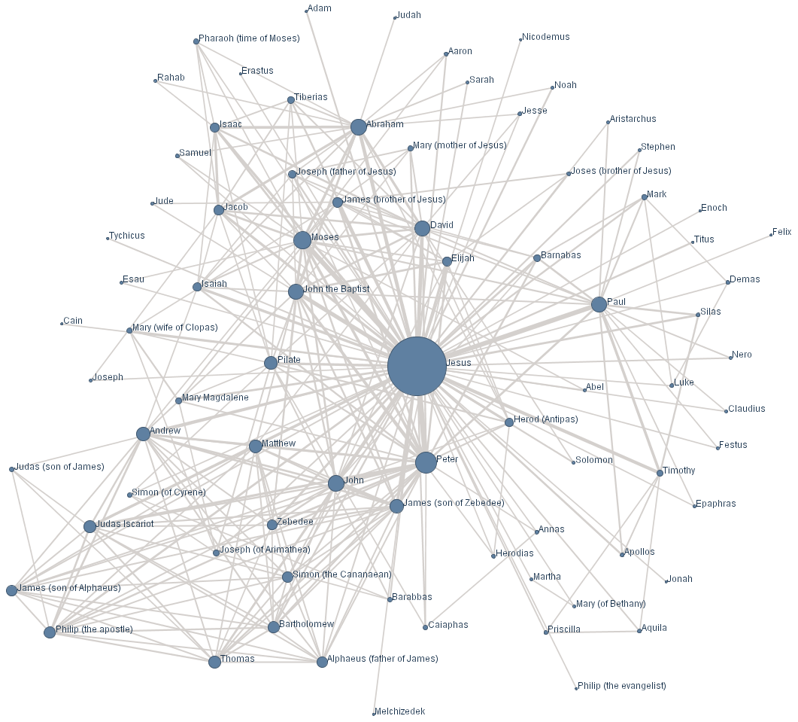
Network Studies
Introduction: Studies in ‘social networks’.
E.g., graph frequency of emails between all entities in an organization
Make deductions about who affects decision making

Slide 4
Network Studies
Bavelas’ idea of network connectivity.
E.g., 5 people in a group: What are the possible communication linkages? What are the constraints?
Measurement of centrality.
Centrality ~ Ease of communication with others and vice = versa.
wheel
circle

Slide 5

Network Studies
Basic experimental set up
Task (6 possible marbles: B, Y, G, R, W, P). Every member has a box of 5 marbles. There is only one marble that is common to all team members
Each member sits in his/her cubicle, and they communicate with others through messages through openings in the cubicle. You measure how long it takes them to find the common color.
Why use such a simple task?
Because you don’t want to add other variables (e.g., intelligence)
Study 2: Introduction of noise – marbles are multi-colored.

Slide 6

Network Studies
7
6
4
Notes:
4*7= 28 + 4 for the middle= 32

Slide 7
Network Studies: Results
Wheel
time = 21 - 46 sec.
Errors = 2 %
# of messages = 8 - 10
response to innovation = Negative
morale = poor
noise = no recovery
leadership = yes
Circle
time = 50 - 96 sec.
Errors = 9 %
# of messages = 18 - 33
response to innovation = positive
morale = good
noise = recovery
leadership = no

Slide 8
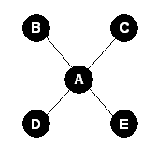
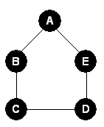
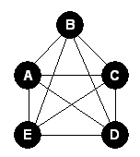

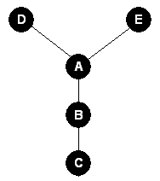
Different types of Communication Structures
Wheel
Circle
Fully Connected
Line
Tree / Y

Slide 9
Game: Bavelas-Leavitt Experiment
Divide into groups of 4-5
If needed, one or more may be assigned as “observers”
Your group will be assigned one of the communication structures (Wheel, Circle, Line, Fully Connected, Tree)
Solve the puzzle with your group
The puzzle is solved when every single player is able to put together the square.

Slide 10
Game: Bavelas-Leavitt Experiment
Goal: Each person should put together the square.
The faster, more efficiently you can do it, the better.
You can only give or accept given pieces, you may not take one from someone else!
You can’t complete someone else’s puzzle for them

Slide 11
Game: Bavelas-Leavitt Experiment
Discuss (5 minutes):
How did you communicate toward solving the problem?
How effective was your communication?
In which groups/situations, would your assigned communication structure be useful?
Did you have a leader?
Discuss your findings with the class

Slide 12
Game: Bavelas-Leavitt Experiment
In each network, perform a theoretical analysis at each node: how many messages are needed to reach all other notes? What is the total “communication distance” in each network? Does your analysis reveal any patterns of centrality?
What network were you assigned in the activity? Describe your experience. In your answer, consider answering the following questions: Were there any differences between how each of the team members felt during the exercise? Did a leader emerge? What was the response to innovation (e.g., were good ideas utilized promptly?). What were the greatest difficulties? Did the experience match the theoretical communication distance and centrality analysis performed earlier? Why or why not?
Can you relate your experience (or the experience of other teams) in your group activity to any real life situations of group work? Explain.

Slide 13
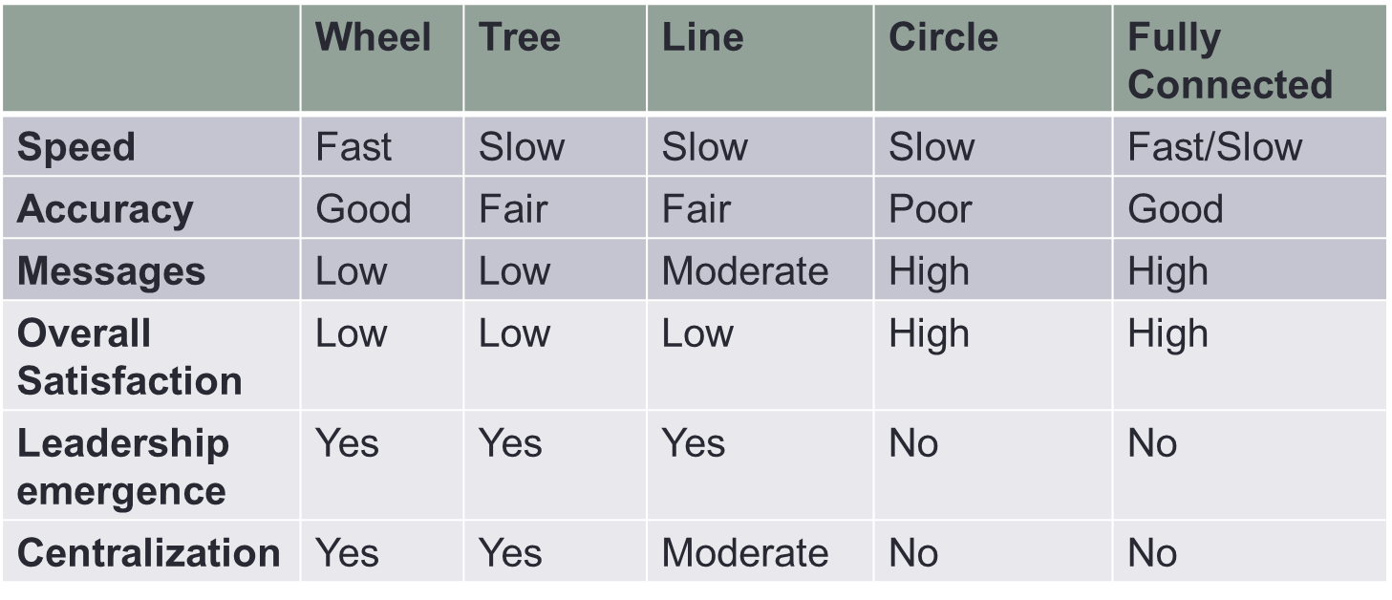
Theoretical Effect

Slide 14
Explanation
According to Bavelas and Leavitt, the more centralized a structure is, the better it performs. They use "centrality" to refer to the overall distance that nodes are from the most central node, who acts as an information integrator. The closer everyone is to that integrator, the faster the puzzle is solved. Of course, channeling all information to a single integrator is not the only possible strategy for solving problems. But it is a reasonable strategy that is easy to implement and which works well with simple problems. People seem to gravitate toward that kind of solution naturally, and so structures that lend themselves to funneling to an obvious center tend to perform better. In the centralized systems, the most central node is clearly more central than all the other nodes. This makes clear who the leader is, and also makes the funnel-everything-to-an-integrator strategy more obvious. So centralized systems don't waste time searching for a strategy nor vying for leadership: they just do it.
Later research, however, has shown that centralization is not always optimal. The next table shows under which conditions and criteria centralized vs decentralized systems are best.

Slide 15
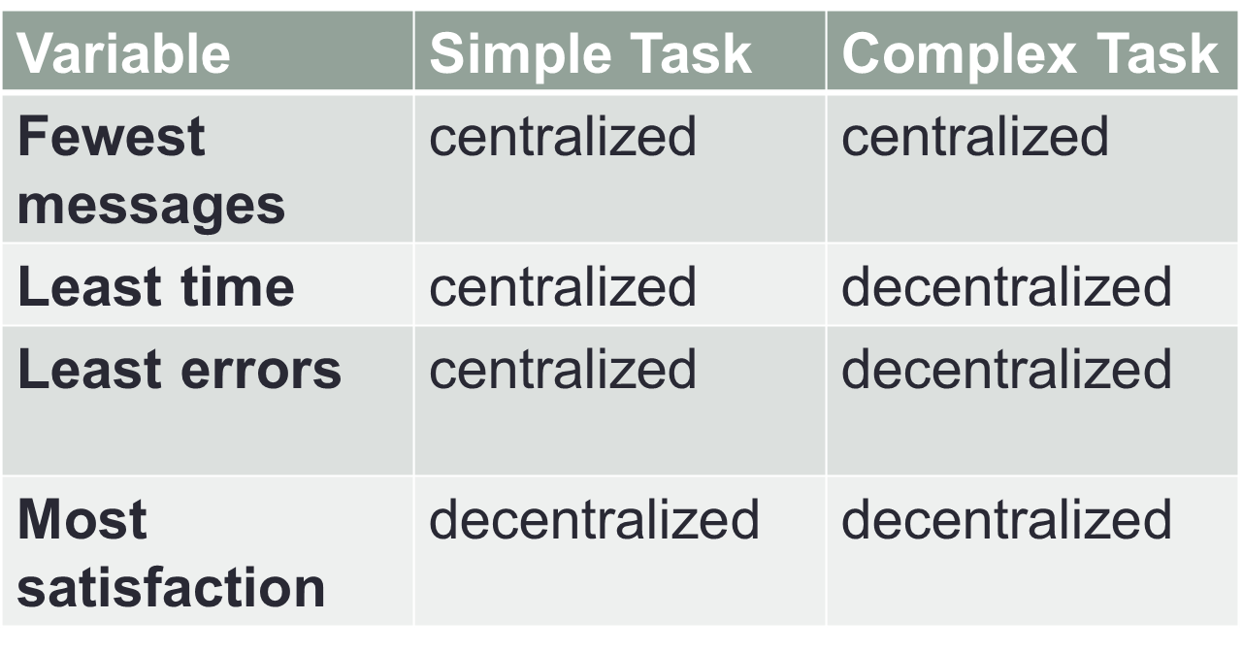
In general

Slide 16
Explanation
Centralized systems don't work as well with complex tasks because some problems are too big for an individual to handle: the whole idea is to use the entire organization as a distributed processing unit to solve problems that no one person could possibly handle. Also, with large systems (many nodes) central nodes can be overwhelmed with communications. In addition, in such systems, most of the network remains idle while waiting for information to filter back from the center.
One reason for this is that in the centralized systems, the number of possible patterns of communication was much smaller. People were more or less forced to adopt a certain strategy for solving the problem. In contrast, for the circle, there were many many possibilities, only a few of which worked well. Even if they all worked well, it was much harder for people to choose one strategy and stick to it. It is often the case in organizations that a satisfactory strategy that is easy to find, implement and stick to is superior to an optimal strategy that is hard to find, hard to implement, and hard to stick with.
It is also helpful if the strategy that a structure pushes people towards is one that people are naturally positively disposed towards. For example, people readily understand leadership. It is much harder to understand the system which, in the circle, would actually lead to much faster performance than the integrator strategy.

Slide 17
Wheel
Centralized network
Lower satisfaction.
Leader is more clearly defined

Slide 18
Line / Chain
When the communication is restricted only to certain group members, but all are somehow connected.
Members satisfaction is better than the ‘wheel’ pattern.
Major drawbacks:
Do not work as a team
Weak leadership
Lack of coordinated effort

Slide 19
Circle
Similar to the Line pattern with the last 2 members also connected.

Slide 20
Tree / The Y
Similar to the Wheel structure

Slide 21
Fully Connected
Decentralized network
More democratic, but can be very slow
Everyone can interact with everyone
Leadership is unclear as it is shared by all members

